Slide 1
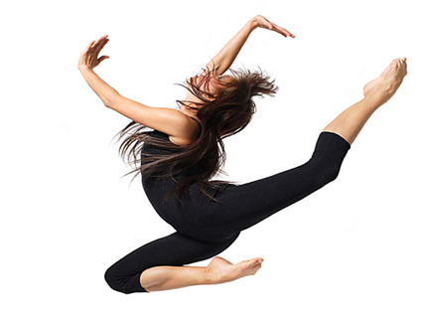
LESSON 3
YEAR 9 DANCE
DANCE SKILLS UNIT .

Slide 2

LONG TERM OBJECTIVES
explore and develop your dance skills and review your own practice
use your dance skills within rehearsal and performance.

Slide 3
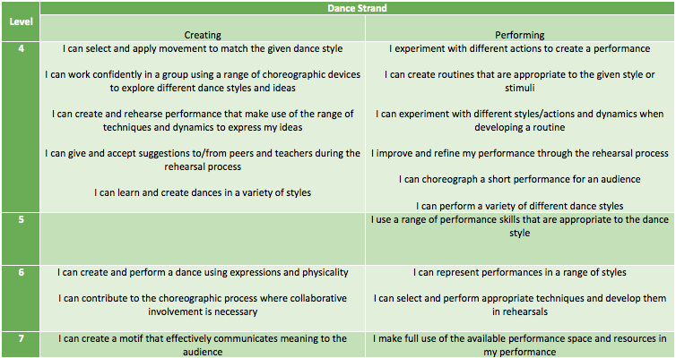
SUCCESS CRITERIA

Slide 4

NUMERACY TASK
HOW MANY BEATS ARE THERE IN THE OPENING SECTION OF YOUR STREET DANCE ROUTINE?

Slide 5
KEY WORDS OF THE LESSON
MOVEMENT MEMORY
CORE STABILITY
MUSICALITY
DYNAMICS

Slide 6
WHAT ARE THE COMPONENTS OF A WARM UP? WHY IS IT IMPORTANT TO WARM UP?

Slide 7
TIME TO WARM UP ☺

Slide 8
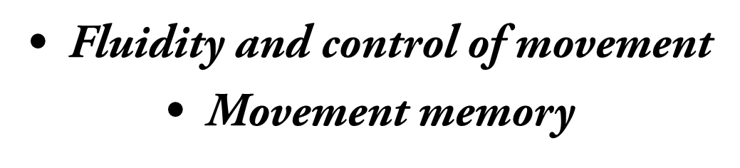
RECAP STREET DANCE ROUTINE
FOCUS ON THE FOLLOWING:

Slide 9
PLENARY
WHAT HAVE YOU DONE WELL AT TODAY?
WHAT DO YOU NEED TO IMPRVE ON AND WHY?
DO YOU KNOW ALL OF THE KEY WORDS AND THEIR DEFINITION?

Slide 10
HOMEWORK
REHEARSE YOUR STREET DANCE ROUTINE AND WARM UP , IN PREPARTAION FOR YOUR ASSESSMENT NEXT WEEK.

